Slide 1
Expenditure Report by Country
By: Isha Terdal

Slide 2
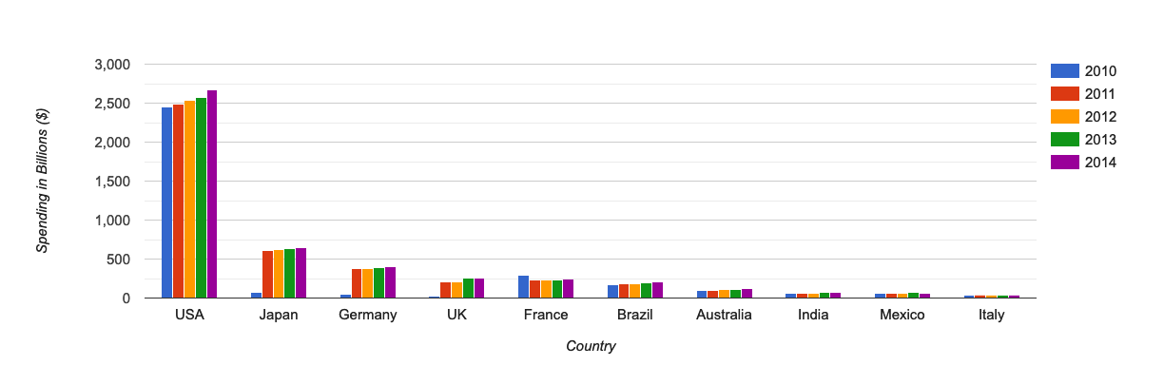
Healthcare Expenditures by Country(2010-2014)
USA shows the strongest record of spending in healthcare with a consistently high record over the years
India, Mexico, and Italy present minimal coverage for healthcare spending

Slide 3
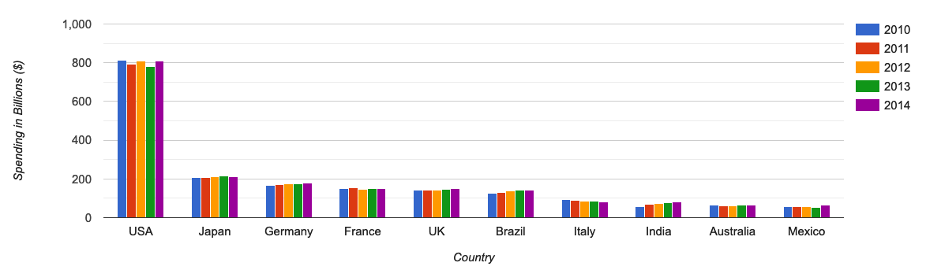
Education Expenditures by Country(2010-2014)
All countries have maintained a consistent portion of the GDP spent in Education initiatives
USA tops the charts again with close to 800 billion dollars in total education expenditures per year, followed by Japan and Germany

Slide 4
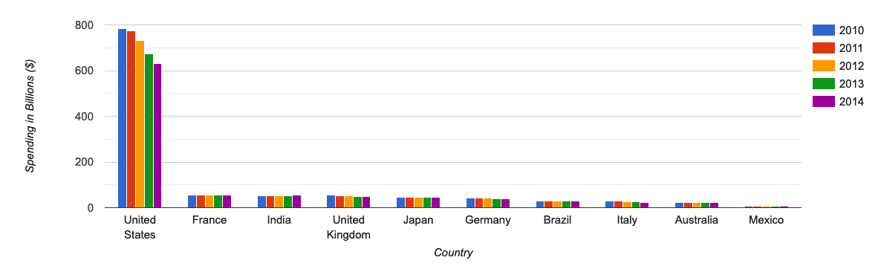
Military Expenditures by Country(2010-2014)
While the military spending has lowered over the years in the United States, India shows a slight hike in recent years.
Mexico portrays minimal expenses for military development in the years studied

Slide 5
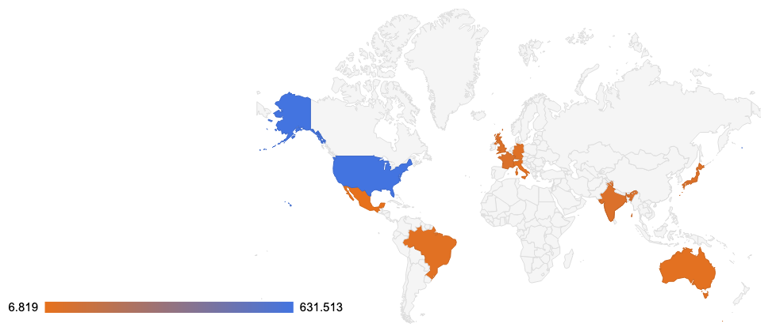
Military Expenditures Around The World(2014)

Slide 6
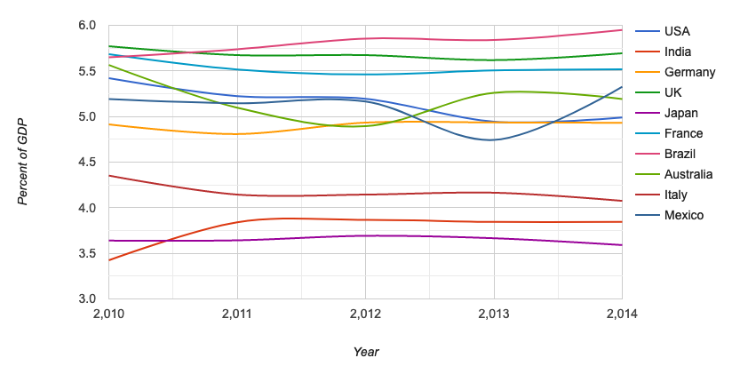
Share of Education Expenditures in GDP(2010-2014)

Slide 7
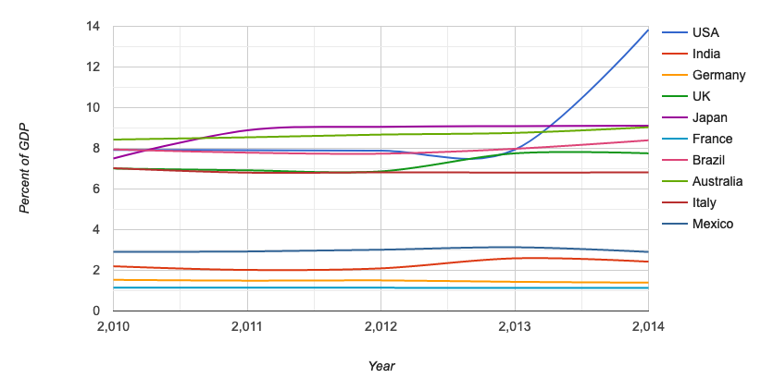
Share of Health Expenditures in GDP(2010-2014)
USA shows a significant increase in Healthcare spending from 2013

Slide 8
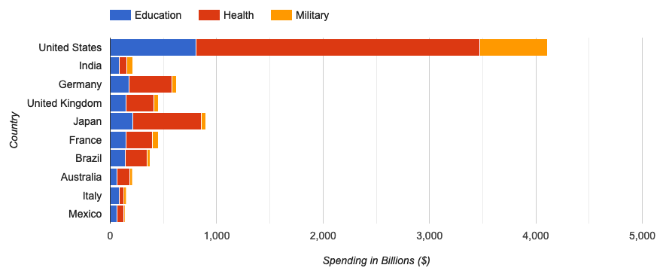
Share of Education, Health, and Military Expenditures in GDP(2014)

Slide 9
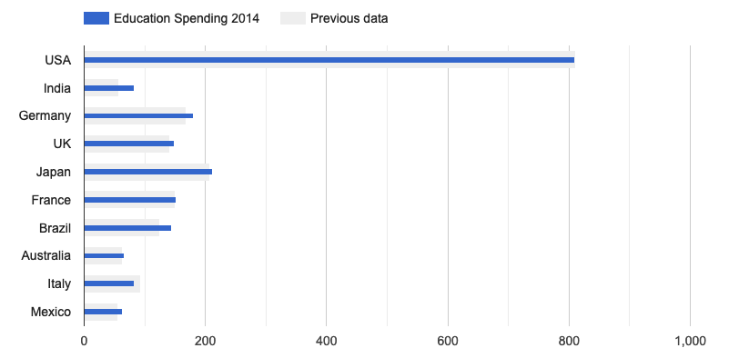
Education Spending Growth Rate(2010-2014)

Slide 10
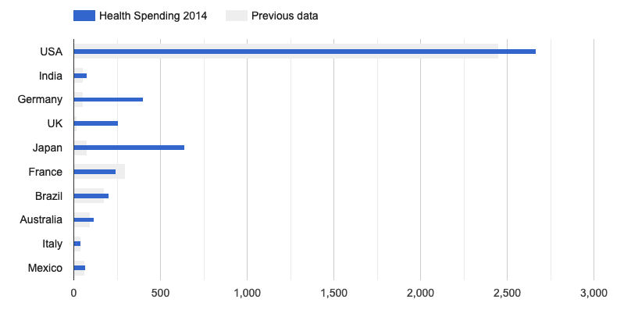
Health Spending Growth Rate(2010-2014)

Slide 11
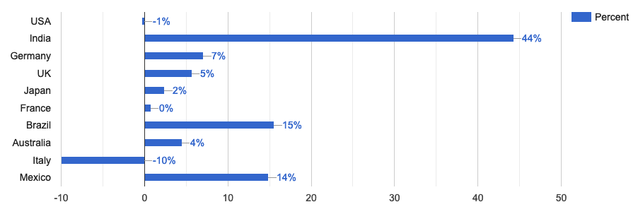
Education Growth Rate In Percentage(2010-2014)
India shows a 44% growth rate in education spending, followed by Brazil and Mexico

Slide 12
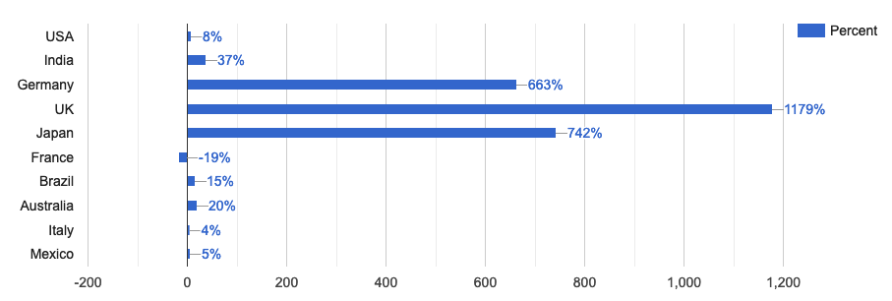
Health Growth Rate In Percentage(2010-2014)

Slide 13
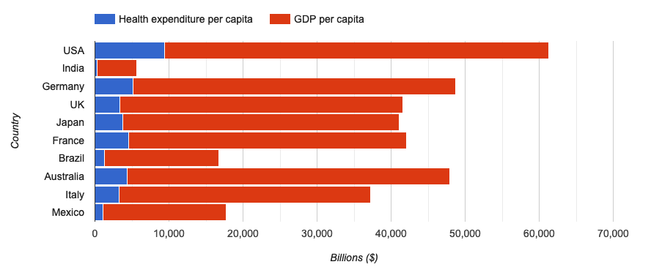
Health vs. GDP Expenditure per capita(2014)

Slide 14
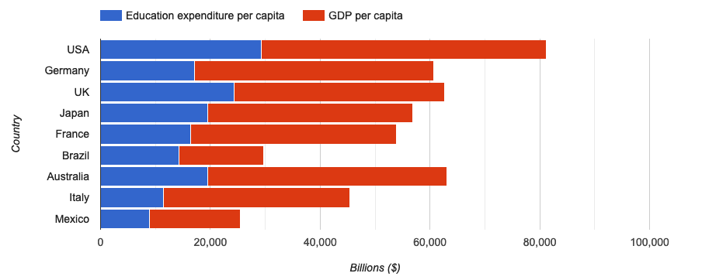
Education vs. GDP Expenditure per capita(2014)

Slide 15
Conclusions
The United States shows a strong and consistent record of spending across all education, healthcare, and military expenditures
India shows a 44% growth rate in education spending, while the United Kingdom has recorded exponential growth in healthcare spending
All countries have been mostly consistent in their spending for education and healthcare from 2010 to 2014, with the exception of US spiking in healthcare expenses from 2013

